Slide 1

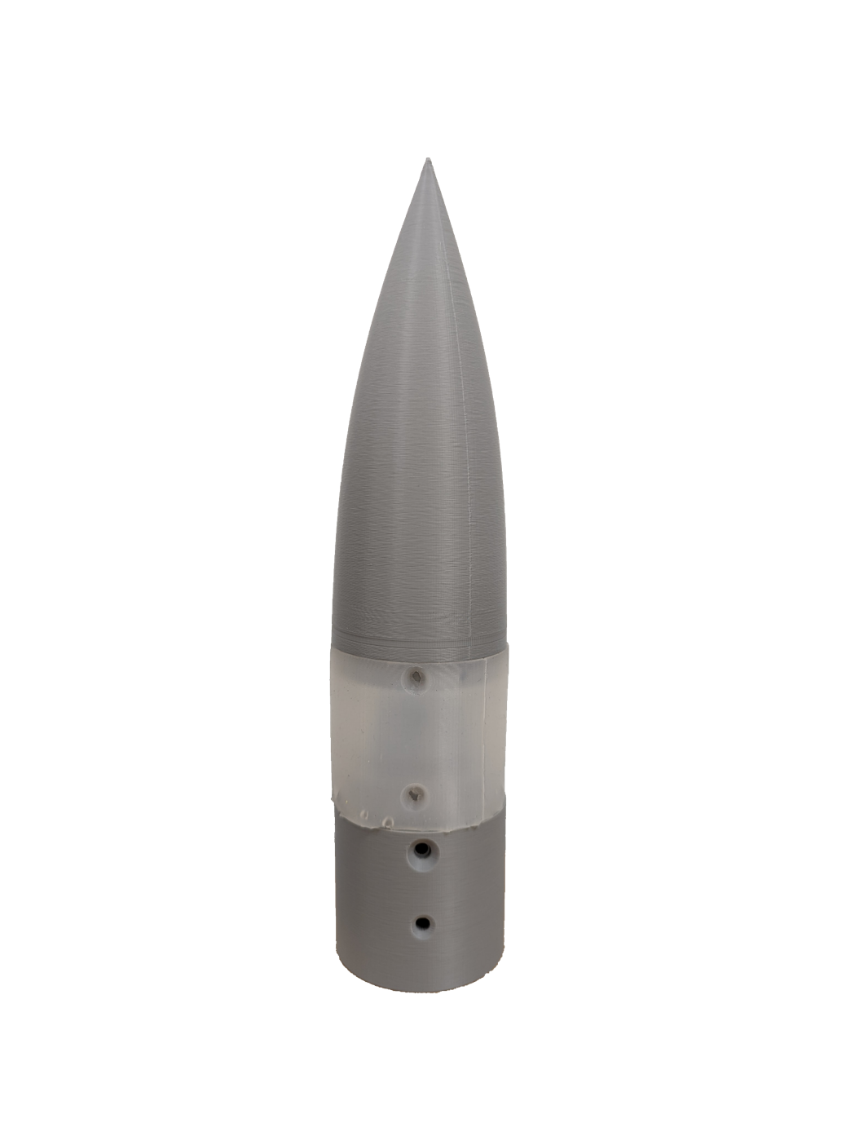
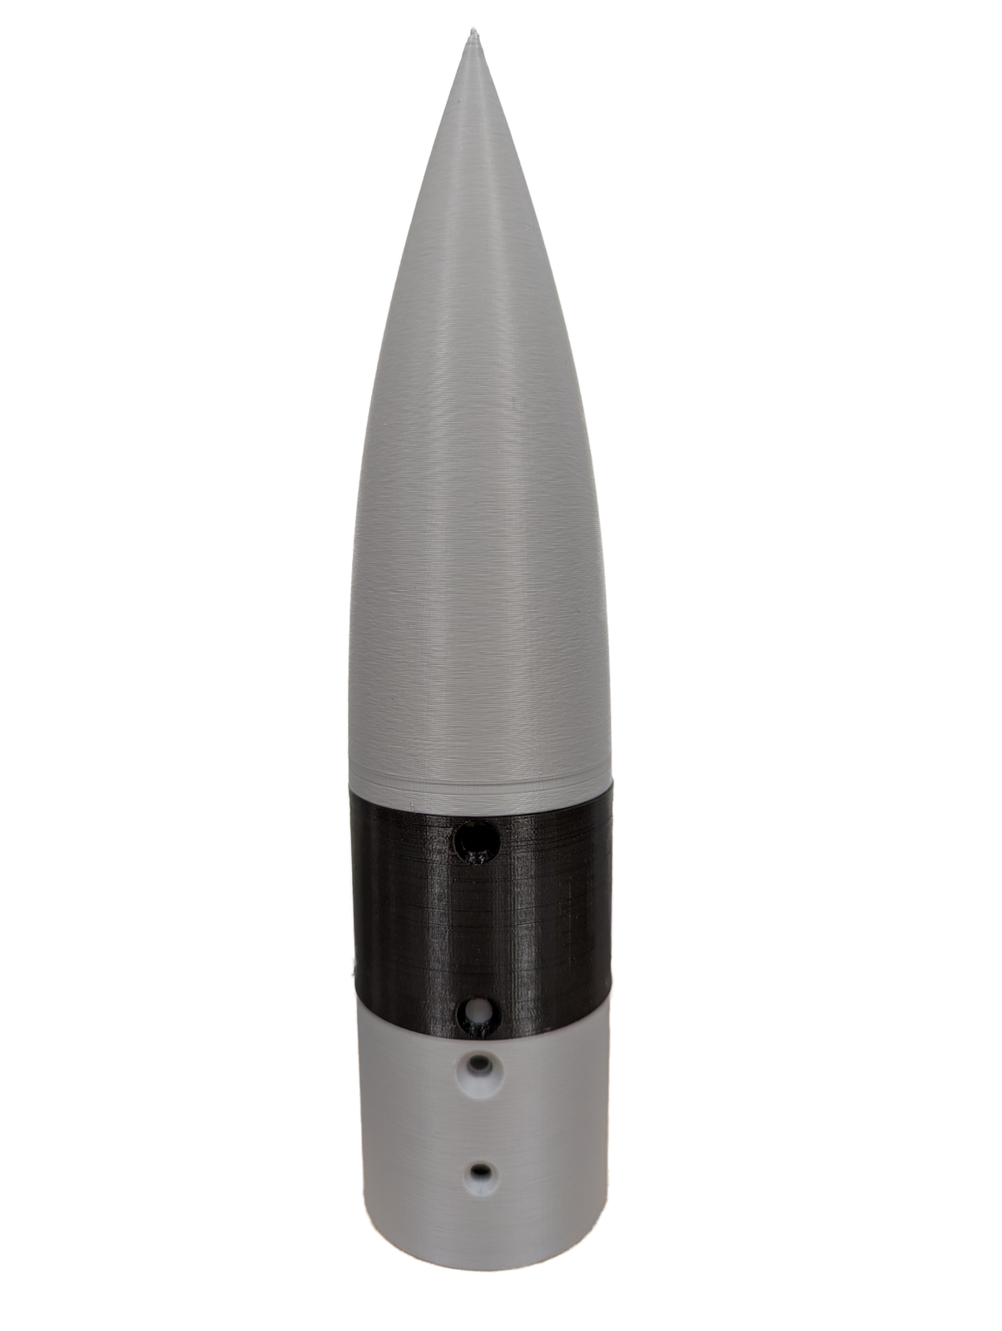
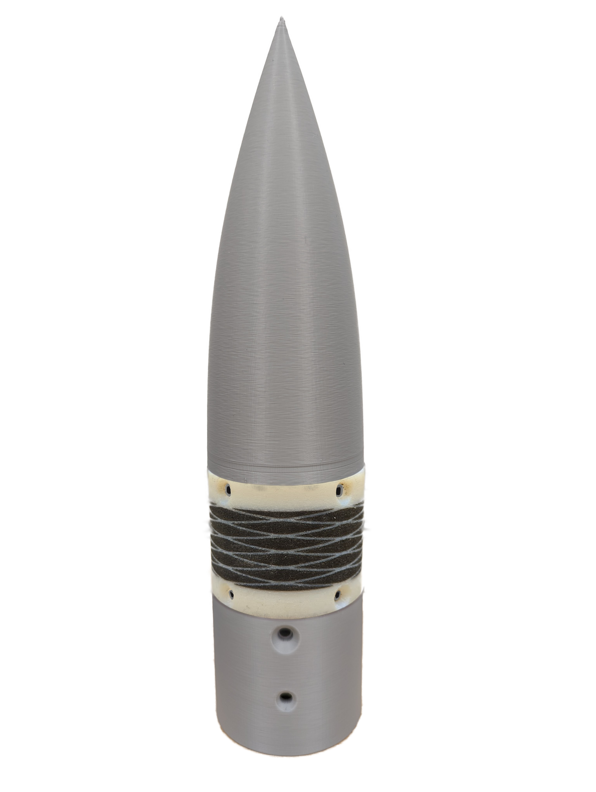
Articulating Nose Cone
Team 504: Jed Fazler, Noah Moffeit, Nicholas Samuda, Robert Smith​
Project Objective:
Nose Deflection Process:
Design the method of articulation for a nose cone during testing in a low-speed wind tunnel while keeping a smooth edge transition
Surfaces rotates to produce up to 20°
Body rotates up to 360°
Contact Surface:
20°
2 in.
Universal joint allows for power transmission and deflection
16 in.
Goals:
Flexible Sleeves:
Articulate nose cone to pitch and yaw ±20°
Eliminate edge effects at the interface of the nose cone and body
Multiple sleeves designed to bend with the missile’s rotation
Silicon-Resin Based Cast
Single Filament 3D Print
Multi-Filament 3D Print

